Slide 2
Program Basics
YourTurn is Erie Insurance’s new rewards-based telematics program for drivers.
Drivers of all ages can participate and earn rewards for exhibiting good driving behaviors.

Slide 3
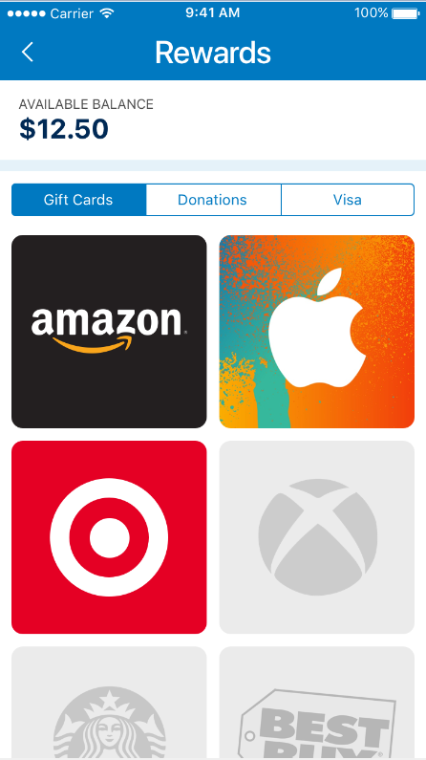
Program Basics
Drive Safely
Get Paid!

Slide 4
Rewards
Every two weeks, users get a score ranging from 40 to 100 and receive rewards for a score of 90 and above. *
Youthful Drivers:
Score of 95 or above = $10.00 reward
Score of 90 to 94 = $5.00 reward
Adults:
Score of 95 or above = $5.00 reward
Score of 90 to 94 = $2.50 reward
* IN only – Both youthful drivers and adults receive $5.00 for 95 or above and $2.50 for 90-94

Slide 5
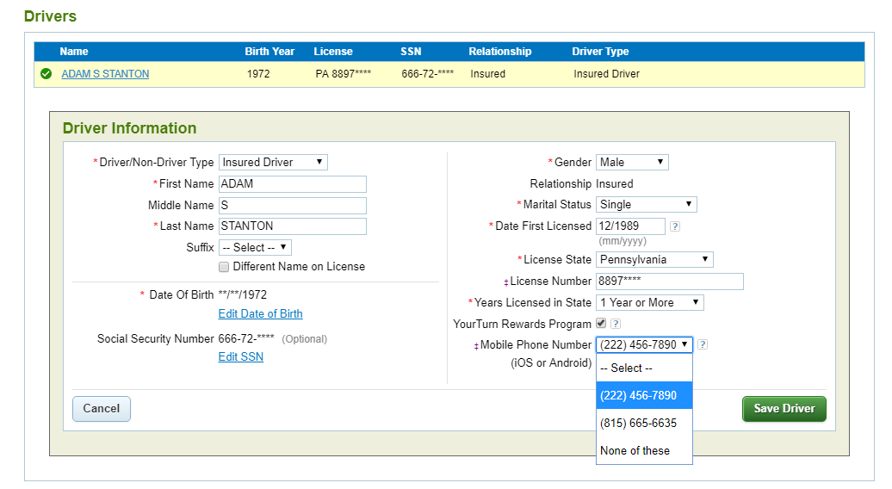
Enrollment in YourTurn
Users can be enrolled through DSpro Web by selecting the YourTurn Rewards Program checkbox on the Driver screen and entering the driver’s smart phone number.

Slide 6
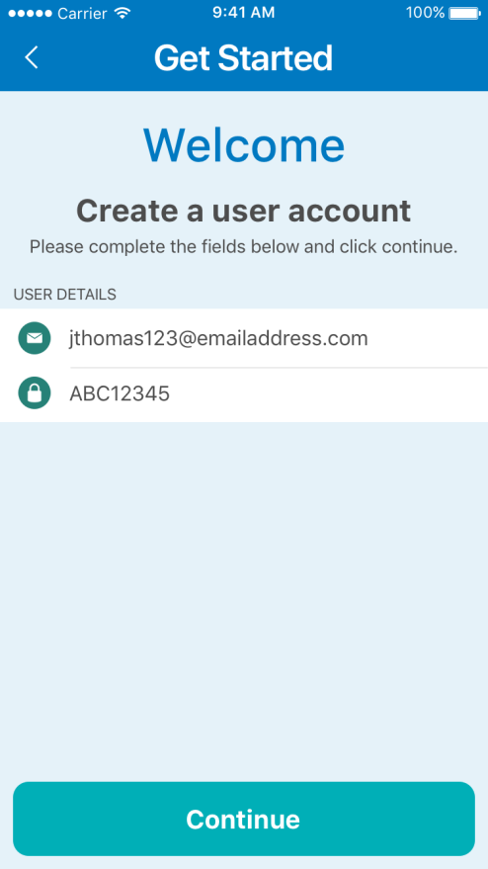
Getting Set Up
Following enrollment through DSpro Web, users will receive a text message with a link to download the app from the App Store or the Google Play store.
Next, go through the account creation process by entering a valid email address where rewards will be sent.
Also, users must accept Terms & Conditions to complete setup.

Slide 7
Getting Set Up
That’s it! Drivers are ready to hit the road and start earning rewards!

Slide 8
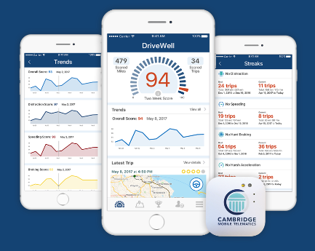
The Application - Overview
The YourTurn application was developed in conjunction with a company called Cambridge Mobile Telematics (CMT).
CMT is a Boston-based company with a long history in the telematics and insurance industries.
CMT’s mission is “making roads safer around the world by making drivers better.”
CMT’s main product is the DriveWell application.

Slide 9
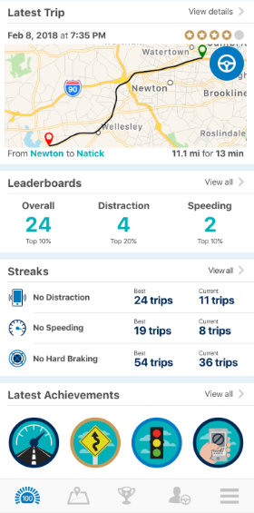
The Application - Overview
The YourTurn application pairs with the in-vehicle tag to track and score drivers on five components:
1. Distraction/Phone Use
2. Speeding
3. Hard Braking
4. Hard Cornering
5. Harsh Acceleration

Slide 10
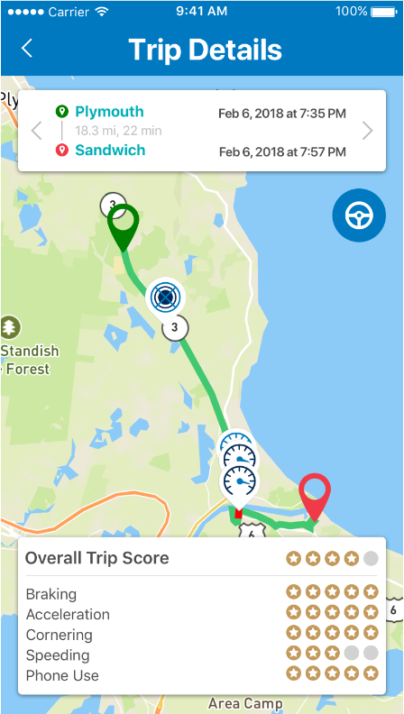
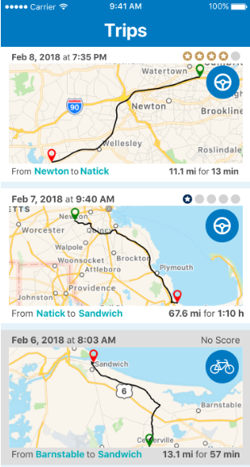
The Application - Trips
Users can get details on trips to see where and when negative events occurred.

Slide 11
The Application - Score
Every two weeks, users get a score ranging from 40 to 100 and receive awards for scores of 90 and above *
Youthful Drivers :
Score of 95 or above = $10.00 reward
Score of 90 to 94 = $5.00 reward
Adults:
Score of 95 or above = $5.00 reward
Score of 90 to 94 = $2.50 reward
* IN only – Both youthful drivers and adults receive $5.00 for 95 or above and $2.50 for 90-94

Slide 12
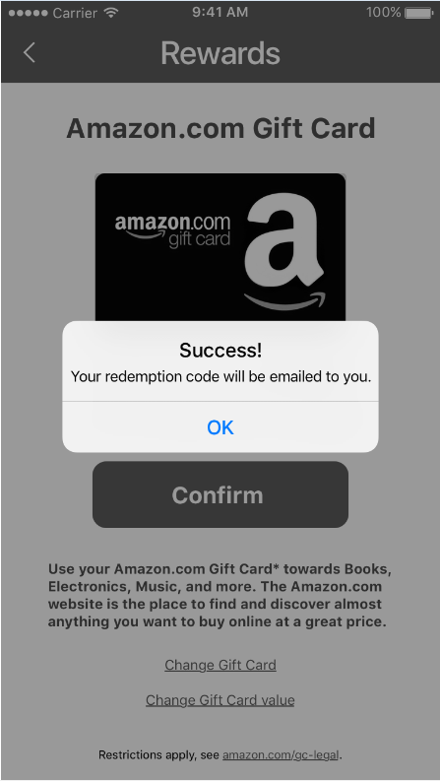
The Application - Rewards
Rewards can be redeemed for gift cards or prepaid Visa cards, or can be donated to charity.
Rewards do not expire.
When redeemed, users will receive the rewards by email.
Scores reset every two weeks and users get the opportunity to earn more rewards.

Slide 13
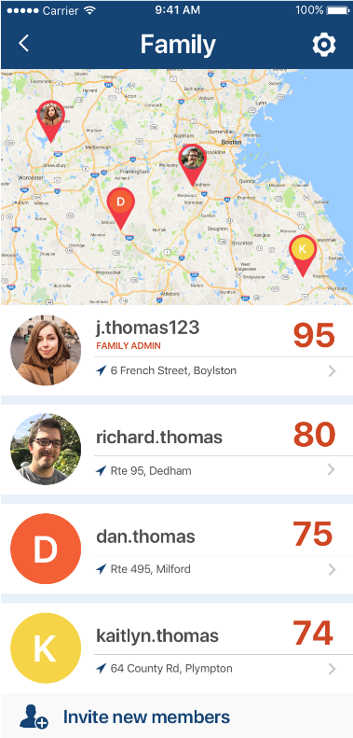
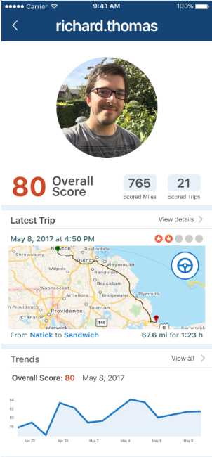
The Application – Family Share
“Family” is an opt-in program that can be created from within the YourTurn application and used by any registered YourTurn participants.
Participating family members can see others family members’ scores and latest location, details on trips, trends, and streaks.

Slide 14
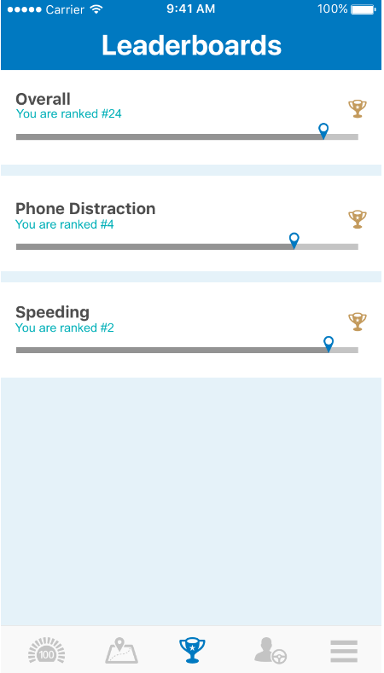
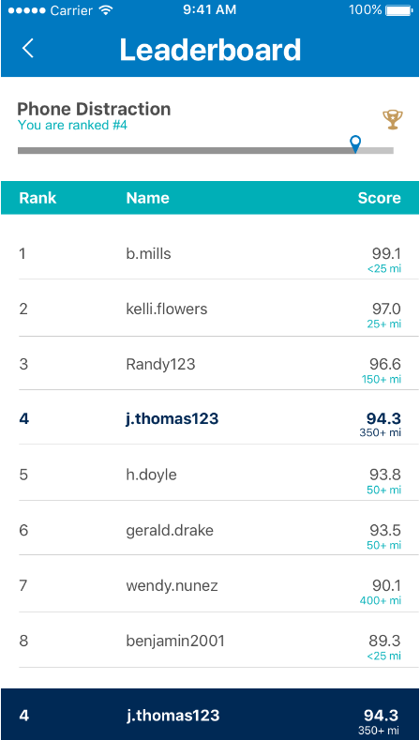
The Application - Leaderboards
Leaderboards let users see how they’re performing compared to their peers.
There are leaderboards for Overall score, Phone Distraction, and Speeding.

Slide 15
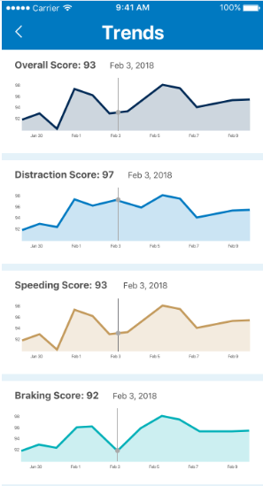
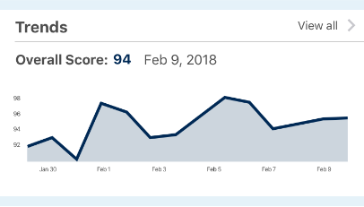
The Application - Trends
Trends give users a view of how their performance is tracking over the course of the two-week scoring period.
Trends are available for Overall Score and each of the scored elements (distraction, speeding, hard braking, hard cornering, and harsh acceleration).

Slide 16
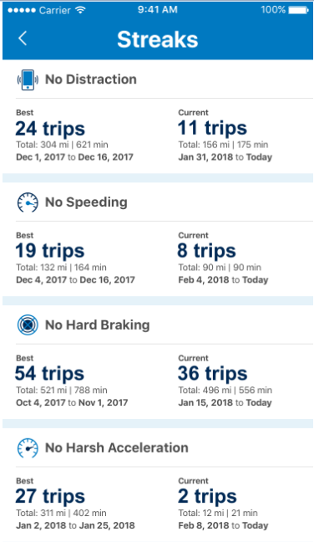
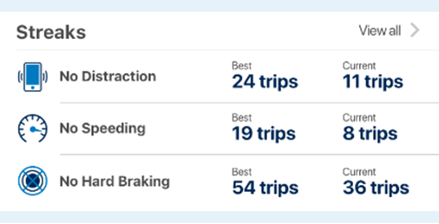
The Application - Streaks
Streaks encourages users to always be on their best behavior by tracking consecutive trips with no negative instances of scored elements.

Slide 17
Questions and Support
Users can get help or ask questions about the program by:
Accessing the “Help” section within the application and referencing FAQs.
Contacting Erie Insurance at YourTurn@erieinsurance.com
For technical issues with the application – contact tech support using the “email us” option within the application.
Agent questions can be directed to YourTurn@ErieInsurance.com

Slide 18
Unenrollment
Participation is voluntary – if a user no longer wishes to participate, they can uninstall the application.
If a policyholder cancels their policy, we will send notice to CMT to have them turn off the application to prevent them from continuing to earn rewards.

Slide 19
Conclusion
Thank you for taking the time to learn about the YourTurn program!

